Slide 1
Quantifying the impacts of hospitals increasing single bed room provision
Andy Hood | Analytics Manager | Strategy Unit | 10th June 2024

Slide 2
0.1 Expectations for this session
Share progress and key findings to date
Gain insights and perspectives from wider stakeholders
Improve messaging and narratives

Slide 3
1. Headlines and Highlights

Slide 4
1.1 Headlines and Highlights (1)
The NHP program advocates for SBR design for new hospitals
Assumption that doing so will reduce inpatient length of stay (circa 12%)
The challenge, therefore, is to quantify changes in LoS and a range of other potential impacts for 7 natural experiments between 2010 and 2022
Identified 12 impact measures
Used an approach called Causal Impact Analysis to detect pre-post changes in trend
Results (much like the published literature) are mixed…

Slide 5
1.2 Headlines and Highlights (2)
For productivity and Efficiency measures, length of stay generally improved (4/6), waiting times reduced (3/5), Bed Occupancy increased (3/4), Emergency readmissions fell (4/7), cleaning costs reduced (2/3)
For health and safety measures, in-hospital deaths fell (3/5), falls and injuries increased (3/4), HCAI reduced (3/3)
For patient & staff experiences, friends and family scores increased (3/5), staff sickness increased (4/7), staff turnover fell (3/3), staff satisfaction reduced (4/6).

Slide 6
2. Introduction, approach, summary and recommendations

Slide 7
2.1 Introduction
Since it’s inception, the New Hospital Programme (NHP) has advocated for single bed rooms (SBR). The grounds for this are based on a range of guidance, evidence and previous policy statements of intent. Whilst that position is unequivocal, there is uncertainty around the quantification of impacts of such a change and thus the assumptions that feed into demand and capacity models and economic business cases for current and future new hospital developments.
Specifically, a starting assumption was that a length of stay reduction of 12% was likely for all new SBR facilities compared to prior trends. This assumption was criticised by the national audit office (NAO) (Office 2023) in the face of a mixed evidence base.
It is the express aim of this analysis therefore to quantify the range of likely impacts for length of stay and a basket of other measures across patient & staff experience, productivity and health & safety.

Slide 8
2.2 Approach
Previous literature reviews and general searches were undertaken to identify potential impact factors.
Identified relevant measures or proxy measures from publicly available data and routine data sources.
Included only those with sufficient time series and of acceptable data quality into final impact framework.
Cleansed and compiled all the data into time series format.
Identified ‘control’ sites and providers to compare to our natural experiment sites.
Several stages of this matching according to hospital function, size, case-mix and admission ratio’s.
Performed causal impact analysis on the pre and post intervention periods to detect the nature and scale of impacts for each natural experiment.
Aggregated findings for the non-specialist hospitals.

Slide 9
2.3 Summary of key findings (1)
Our results are generally not consistent within indicators and across hospital sites. This inconsistency is reflective of the findings from published literature. Two impact measures moved in the same direction across all (eligible) sites - C-diff decreasing and staff turnover decreasing.
This suggests that there are other factors in the hospital design, systems, policies and cultures that are important. Responses to a qualitative look-back exercise are currently being explored to identify those critical factors that are likely to have exacerbated success or failure.
Switching to single bedroom hospitals without considering these other factors would not necessarily have a positive effect on outcomes nor mitigate any likely risks.

Slide 10
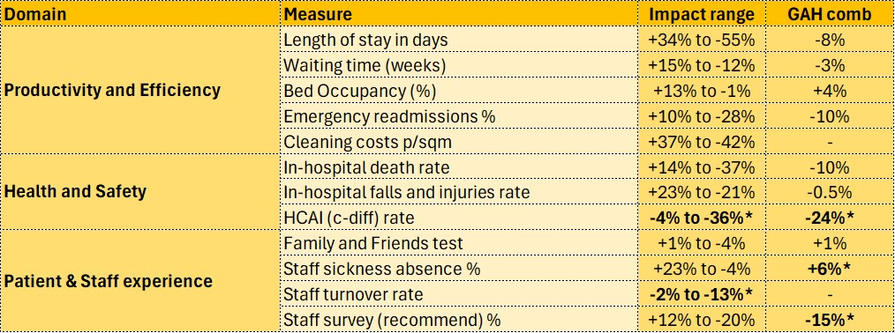
2.4 Summary of key findings (2)
The table across demonstrates the range of impacts across all new hospital sites for each impact measure

Slide 11
2.5 Limitations
Data quality and robustness
No below site-level analysis
Sensitivity/Specificity of some of the measures
Dose-response effects are not possible to ascertain (e.g. an x% change in SBR leads to a y% change in impact A)
Covid 19 bias in some of the pre and post trends
Small pool of control sites and lack of similarity (specialist sites)
Model fit and large credible intervals

Slide 12
2.6 Recommendations
Develop an evaluation framework from (some of) these measures, process indicators and wider evidence (logic model)
Include qualitative survey measures for patients and staff (free text for thematic analysis)
Capture information on design, systemic and cultural factors that may also have bearing on these impacts.
Start collecting data well before the change in bed provision and at least monthly!
System dynamics modelling would aid understanding of multi-factorial productivity impacts.
Length of Stay sub-group analysis i.e. by clinical and patient groups.
Mitigation strategy for staff wellbeing and retention.

Slide 13
3. The impact framework

Slide 14
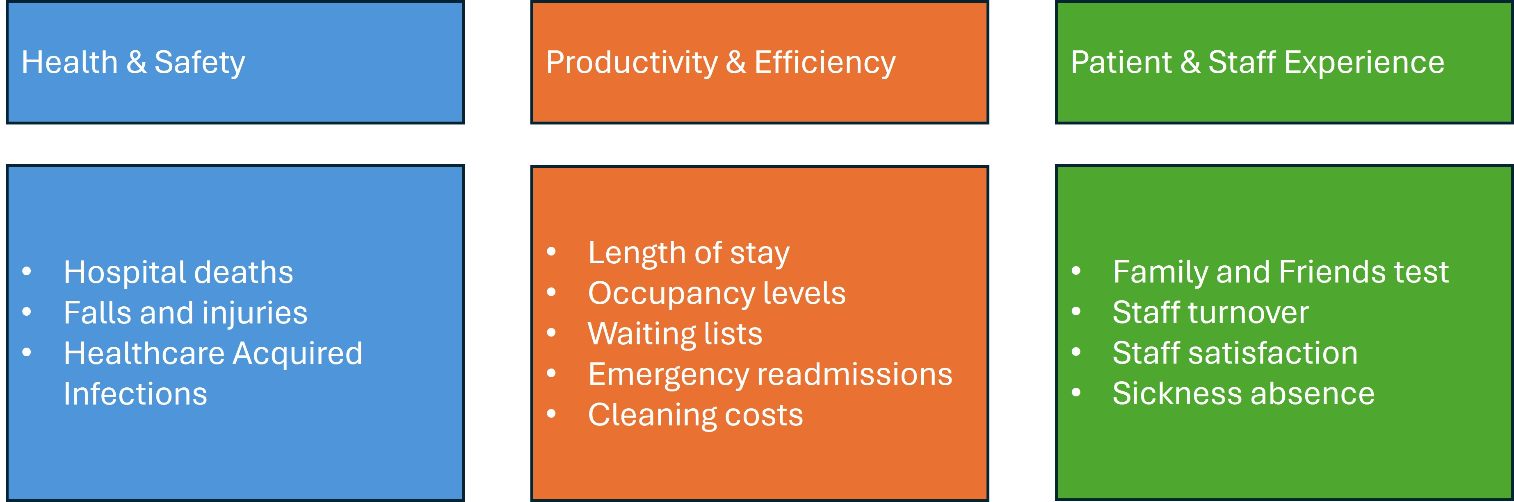
3.1 Overview

Slide 15
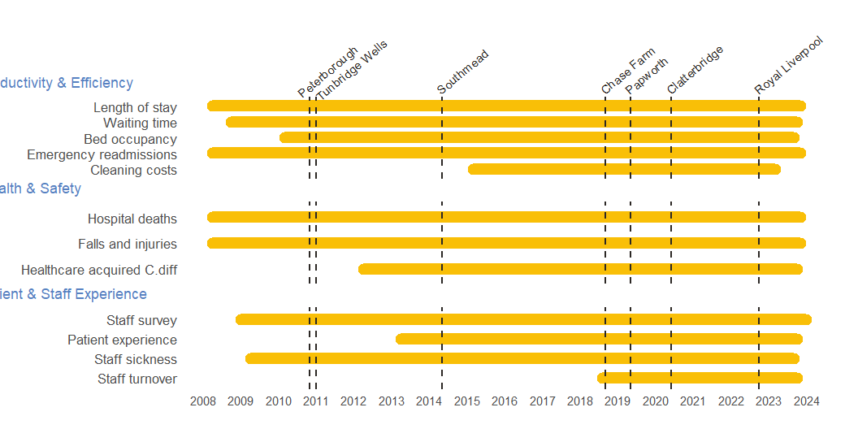
3.2 Indicator availability and time of SBR changes by site

Slide 16
4. The hospitals

Slide 17
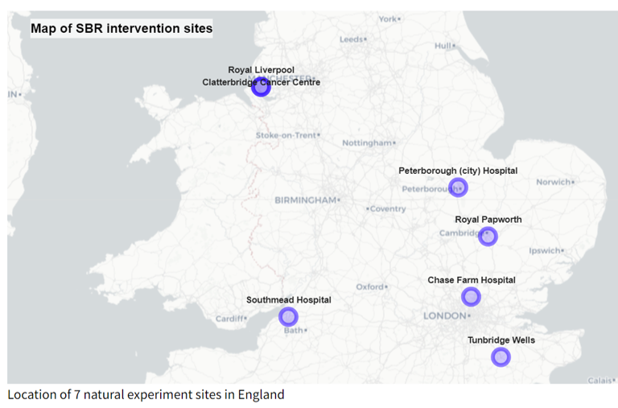
4.1 Seven natural experiments
Royal Liverpool (Oct 2022)
Clatterbridge Cancer Centre (June 2020)
Royal Papworth Hospital (May 2019)
Chase Farm Hospital (Sept 2018)
Southmead Hospital (May 2014)
Tunbridge Wells (Jan/Sept 2011)
Peterborough Hospital (Nov 2010)

Slide 18
4.2 Heterogeneity
No hospital site is the same as another. This is no more true than for our 7 natural experiments. The sites are a mixture of general acute hospitals and specialist ones. They vary in size and function and there are many possible confounding factors in the input-output logic model for our impacts that we can not identify nor account for.
In aggregating some of the findings in this analysis, we have grouped the general acute sites together for indicative purposes. However; the nature of those hospital systems and the social and cultural circumstance should be considerations when both interpreting our findings and also in considering single-bed provision within hospital developments

Slide 19
5. Summary of methods

Slide 20
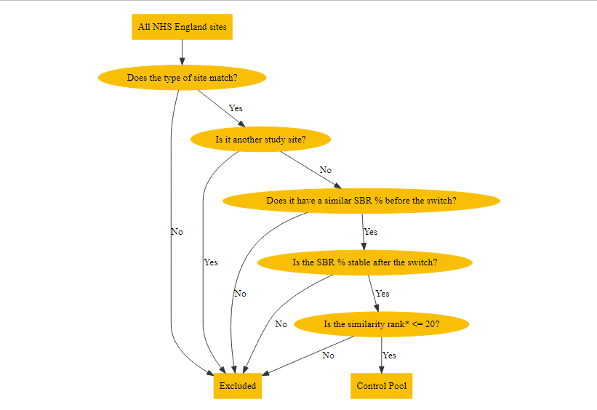
5.1 Selecting control sites
Before including control sites into the calculation of the post-intervention counterfactual, we must ensure they’re similar to the site under study. We do this in several consecutive steps:
Filter on similar site types e.g. General Acute, Tertiary Centre
Exclude those with dissimilar single bed %’s at the point of intervention
Match on (the closest 20) according to the following variables:
Hospital size (m2)
Patient case-mix (median age)
Elective:Non-elective spell ratio

Slide 21
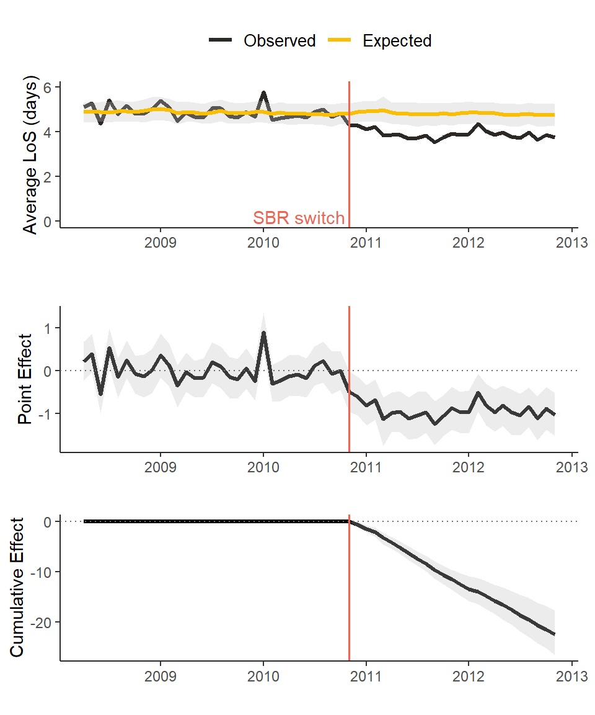
5.2 Causal Impact Analysis
Causal Impact Analysis (CIA), developed by K. Broderson in 2014, explicitly uses prior trends and ‘market-matched’ control analysis to predict a time series. The observed values for the study site are compared to this to determine the direction, magnitude and significance of impacts as a result of the intervention.
All analysis has been performed in R software (v4.3.2+) with the following packages - CausalImpact, MarketMatching, dtw, metafor.
Example of CIA analysis

Slide 22
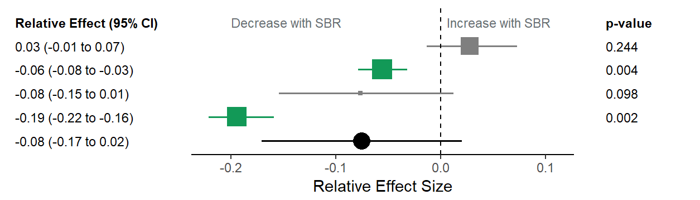
5.3 Aggregating impacts
Where for each impact measure there were 2 or more general and acute hospitals, a meta-analysis was conducted. The specialist hospital sites were excluded from this analysis as it is felt the effects at these sites may not be generalisable when considering future building of general acute hospitals.
A random-effects meta-analysis was conducted using the metafor R package (Viechtbauer 2024) and with the relative effects for each site weighted using the inverse variance, as used for meta-analysis of causal impact models by Schmitt et al. (Schmitt, Tull, and Atwater 2017).
Example of meta-analysis

Slide 23
6. Main results - Productivity and Efficiency

Slide 24
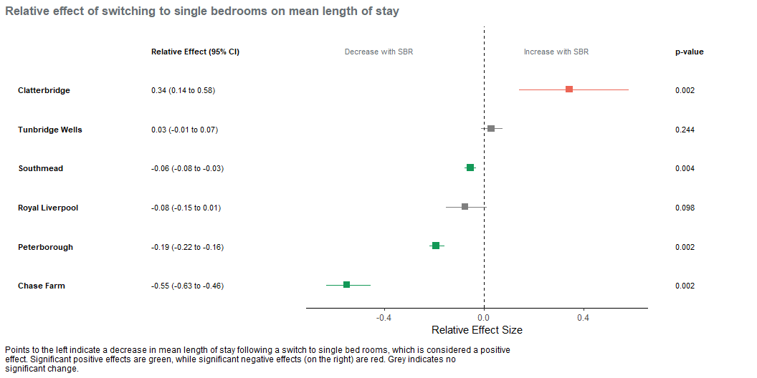
6.1 Length of stay
This monthly data at site level is derived from the Secondary Uses Service (SUS) admitted patients care spells.
Mean length of stay (in days) significantly decreased at 3/6 sites (Southmead, Peterborough and Chase Farm), was unchanged at 2/6 sites (Royal Liverpool and Tunbridge Wells), but significantly increased at Clatterbridge.

Slide 25
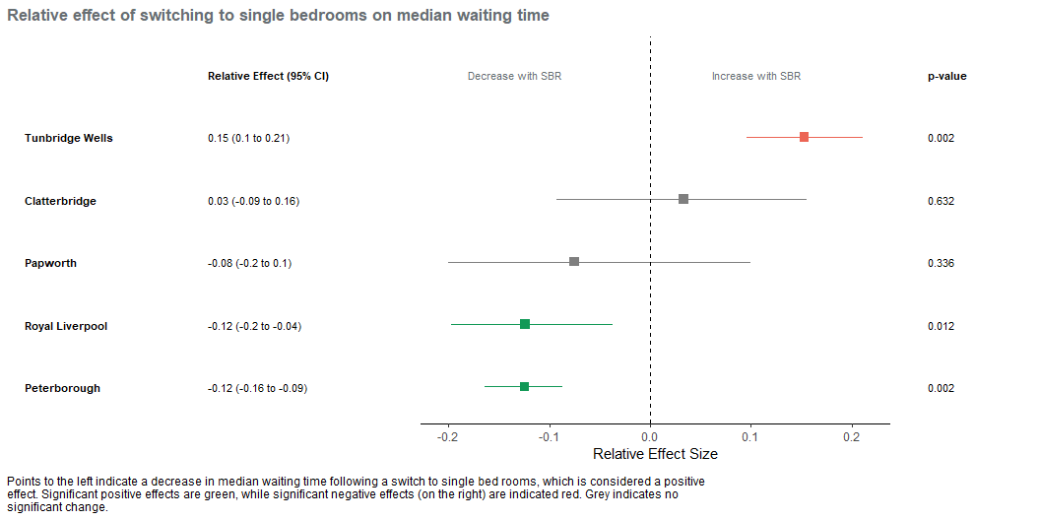
6.2 Waiting time (median)
This monthly data at provider level is from published RTT waiting times dataset (via UDAL).
The median referral to treatment waiting time (in weeks) significantly decreased at 2/5 sites (Royal Liverpool and Peterborough) and was unchanged at 2/5 sites (Papworth and Clatterbridge) and increased at Tunbridge Wells.

Slide 26
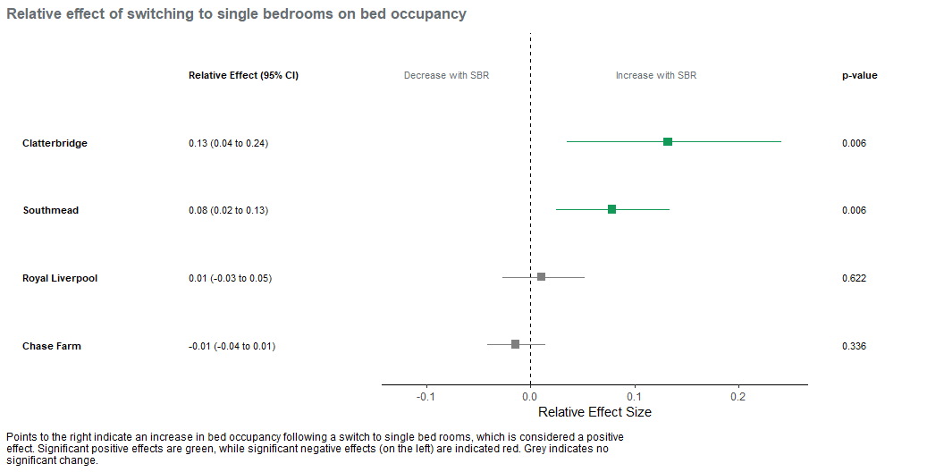
6.3 Bed Occupancy
This quarterly data at provider level is from published KH03 bed returns (via UDAL).
Bed occupancy is measured quarterly and is only available at a Provider level. The percentage of available beds occupied significantly increased at 2/4 sites (Clatterbridge and Southmead) and was unchanged at 2/4 (Royal Liverpool and and Chase Farm).

Slide 27
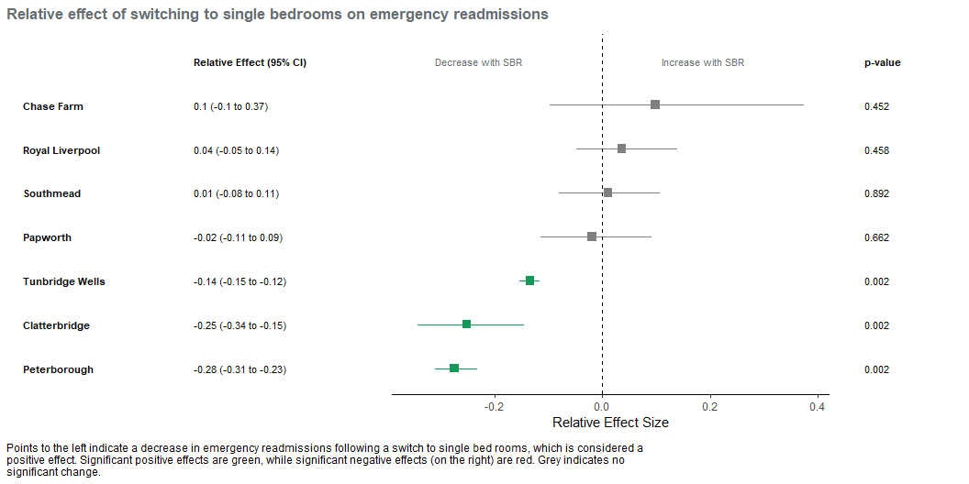
6.4 Emergency readmissions
This monthly data at site level is derived from SUS admitted patient care records.
The percentage of admissions that are emergency readmissions < 30 days of discharge significantly decreased at 3/7 sites (Tunbridge Wells, Peterborough and Clatterbridge) and was unchanged at the remaining 4/7 sites.

Slide 28
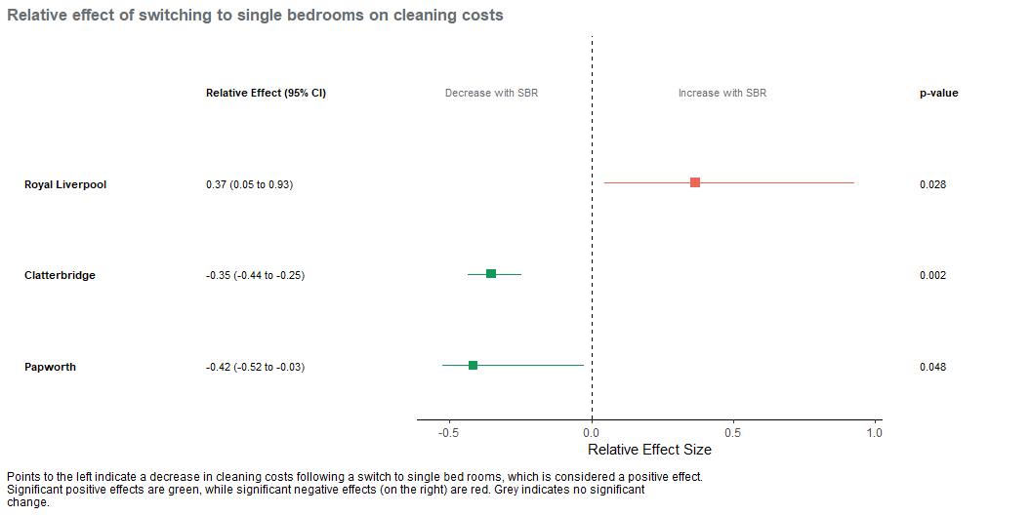
6.5 Cleaning costs
This annual data at site level is taken from published Estates Return Information Collection (ERIC) datasets.
The cleaning costs (in £) per square metre of occupied floor space significantly increased at 1/3 sites (Royal Liverpool) but decreased at 2/3 sites (Clatterbridge and Papworth).

Slide 29
7. Main results - Health and Safety

Slide 30
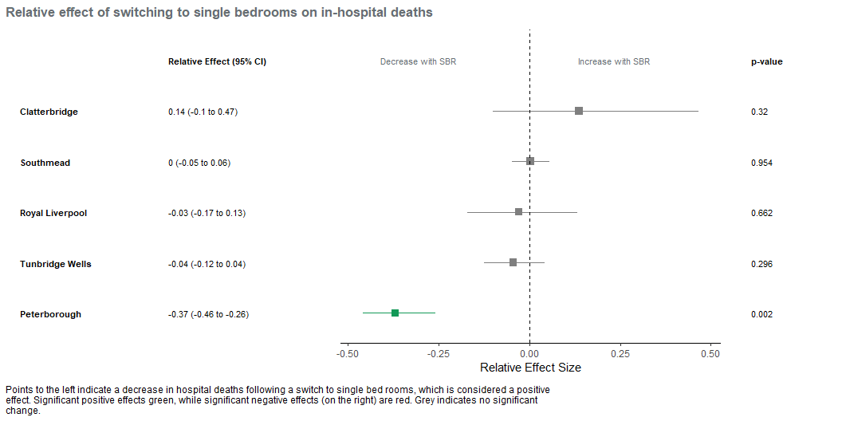
7.1 In-hospital deaths
This monthly data at site level is derived from SUS admitted patient care records.
The rate of in-hospital deaths (number per 1,000 discharges) significantly decreased at 1/5 sites (Peterborough), and was unchanged at 4/5 sites (Royal Liverpool, Tunbridge Wells, Clatterbridge and Southmead).

Slide 31
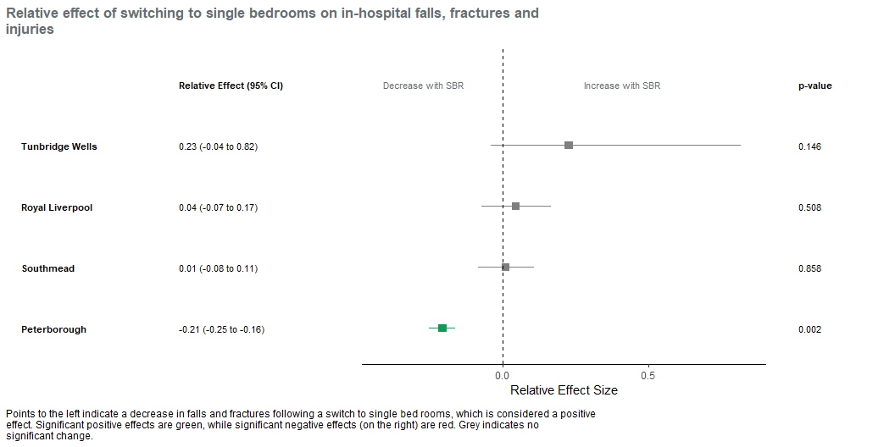
7.2 In-hospital falls and injuries
This monthly data at site level is derived from SUS admitted patient care records.
The rate of in-hospital falls and injuries (% of spells) significantly decreased at 1/4 sites (Peterborough), and was unchanged at 3/4 sites (Royal Liverpool, Tunbridge Wells and Southmead).

Slide 32
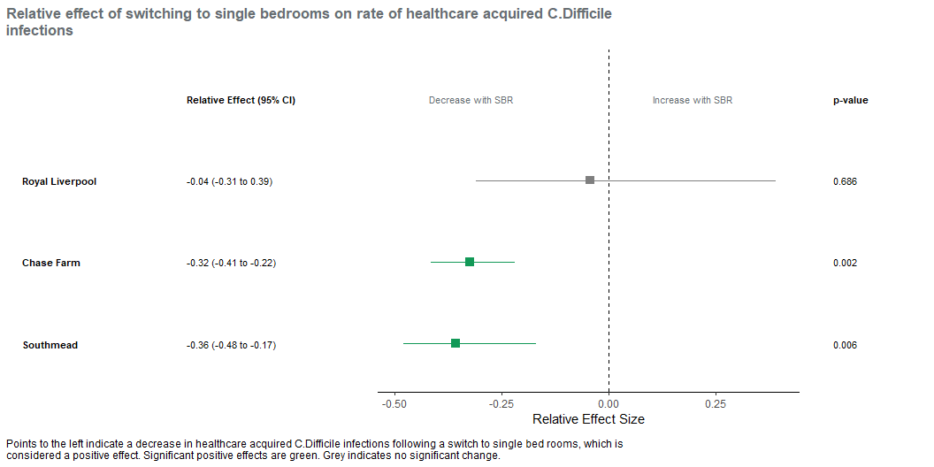
7.3 Healthcare Acquired Infections (HCAI) - clostridium dificile
This monthly data at provider level is taken from published UKHSA surveillance data (via UDAL).
The rate of healthcare acquired C. difficile infections (cases per 10,000 bed days) decreased at 2/3 sites (Chase Farm and Southmead) but was unchanged at Royal Liverpool.

Slide 33
8. Main results - Patient and Staff Experience

Slide 34
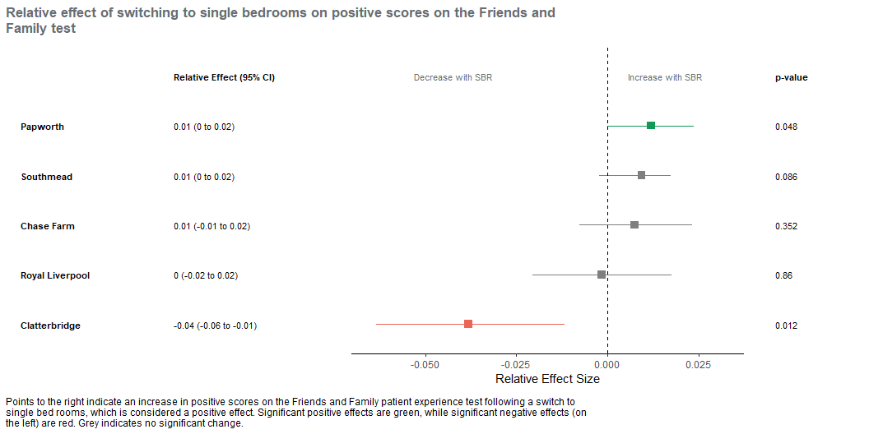
8.1 Family and Friends test
This monthly data at site level is taken from published NHS England data (via UDAL).
The percentage of positive responses significantly decreased at 1/5 sites (Clatterbridge), increased at 1/5 sites (Papworth) and was unchanged at the other 3/5 sites (Royal Liverpool, Southmead and Chase Farm).

Slide 35
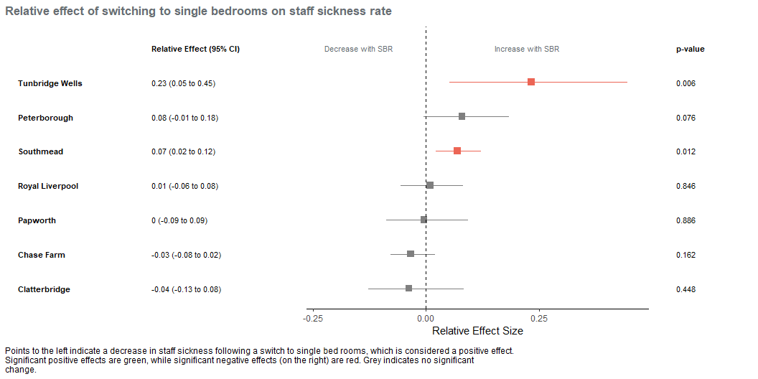
8.2 Staff sickness absence
This monthly data at provider level is taken from published NHS England data (via UDAL).
The percentage of available days taken off sick by staff significantly increased at 2/7 sites (Southmead and Tunbridge Wells) and was unchanged at the remaining 5 sites.

Slide 36
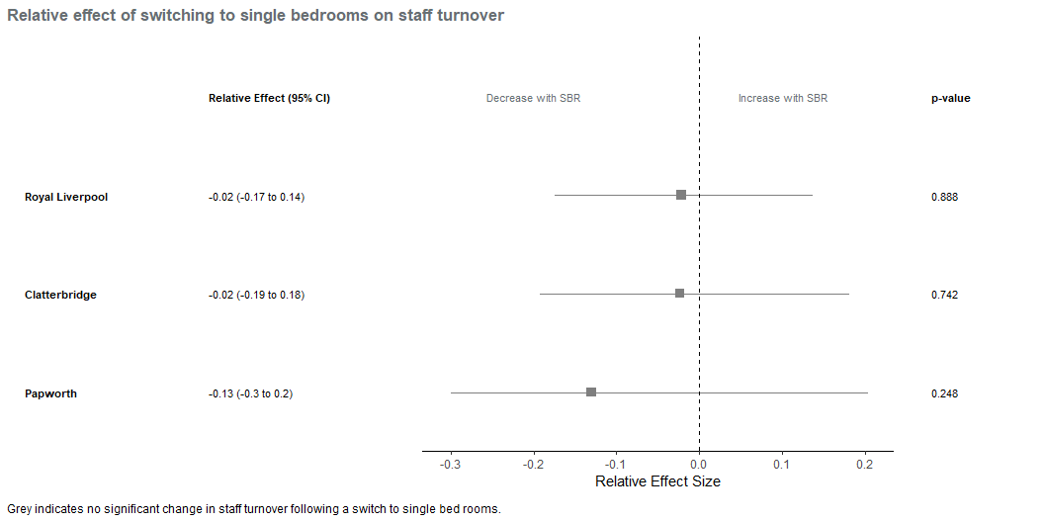
8.3 Staff turnover
This monthly data at provider level is taken from published NHS England data (via UDAL).
Staff turnover measured as percentage of staff leaving was not significantly changed at any of the 3 sites where data was available.

Slide 37
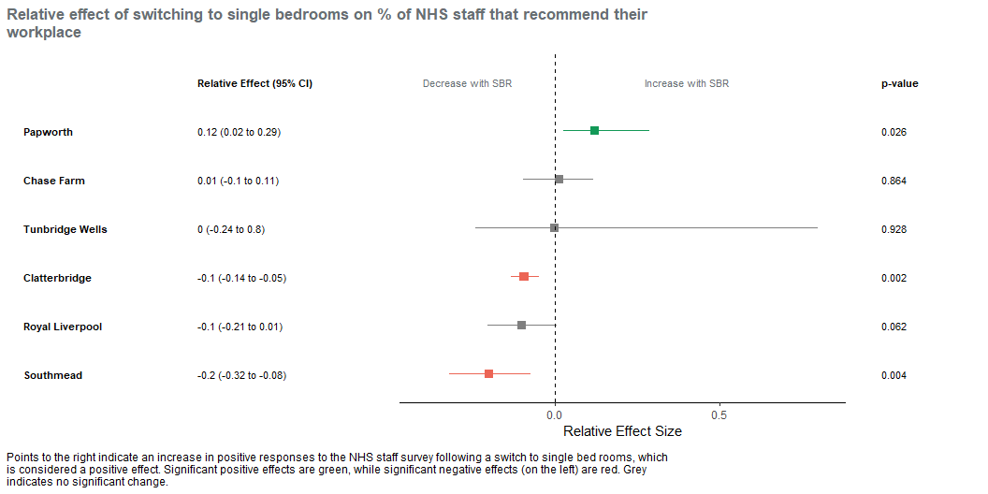
8.4 Staff survey - recommending place to work
This monthly data at provider level is taken from published NHS England data (via UDAL).
The percentage of staff that would recommend their trust as a place to work significantly increased at 1/6 sites (Papworth), and was unchanged at 3/6 (Chase Farm, Royal Liverpool and Tunbridge Wells). At 2/6 sites (Southmead and Clatterbridge) there was a significant decrease in the percentage that would recommend their trust as a place to work.

Slide 38
9. Next steps

Slide 39
9.1 Still on the to-do list…
Triangulate with qualitative look-back exercise
Finish technical report and polish this summary and recommendations
Pass impact parameters to the NHP model team for inclusion
Engage with 7 providers over the results and sharing them
Pursue journal publication

Slide 40
10. Acknowledgements

Slide 41
10.1 Acknowledgements
NHP programme: Cheryl Riotto, Anne White, Joanna Wood, Carolyn Akyil, Michael Weinbren
NHS England: Joshua Igbineweka, Paul Smith
Strategy Unit: Sarah Lucas, Anya Ferguson, Peter Spilsbury, Simon Bourne, Jennifer Wood

